Slide 1



Performance Metrics
by Dristi Dani
DD

Slide 2
An in-depth analysis of Evaluation Techniques & Test Queries

Slide 3

Introduction
Objective
Importance of Evaluation
The Recipe Recommendation Chatbot is a sophisticated AI-driven assistant designed to provide personalized cooking recipe recommendations.
Proper evaluation helps in identifying areas of improvement, enhancing user satisfaction, and ensuring the chatbot's responses align with user expectations.

Slide 4

Project Background
Explore the key technologies and data powering the sophisticated Recipe Recommendation Chatbot, including OpenAI GPT-4, Pinecone, LangChain, and a diverse dataset of cooking recipes.

Slide 5

Evaluation Metrics Overview
Retrieval Metrics: Measure the accuracy and relevance of the chatbot's responses, including Precision, Recall, and Relevance.
Generation Metrics: Assess the quality and coherence of the chatbot's generated output, such as Latency and Robustness.
Importance of Each Metric: Retrieval metrics ensure the chatbot provides useful and relevant information, while generation metrics evaluate the fluency and naturalness of its responses.

Slide 6





Methodology
For Calculating Metrics
Simulate User Queries
Retrieve Contexts & Generate Answers
Automated & Manual Evaluation
Logging & Comparing Contexts
Test the chatbot's responses to a variety of user questions and inputs.
Evaluate the chatbot's ability to provide relevant and coherent responses.
Combine automated metrics with human reviews to assess overall performance.
Track and analyze the chatbot's behavior across diverse user scenarios.

Slide 7

TECHNIQUES tried for EVALUATION
Manual Performance Metrics
Initially chosen due to their straightforward application and ease of understanding
sklearn
Chosen for its powerful and easy-to-use machine learning tools that can automate the calculation of evaluation metrics
RAGAS
Chosen for its ability to automate the evaluation of relevance and other metrics.
It provides a structured framework for evaluating RAG pipelines, making it suitable for our use case

Slide 8




Test Queries & Evaluation
Complex Test Queries
Chatbot Responses
Comprehensive Analysis
To rigorously evaluate the chatbot's performance, I crafted a set of intricate test queries
The chatbot's responses were closely analyzed to assess its strengths, weaknesses, and areas for improvement across the defined evaluation metrics
By thoroughly evaluating the chatbot's performance on the complex test queries, I gained valuable insights to guide future enhancements

Slide 9
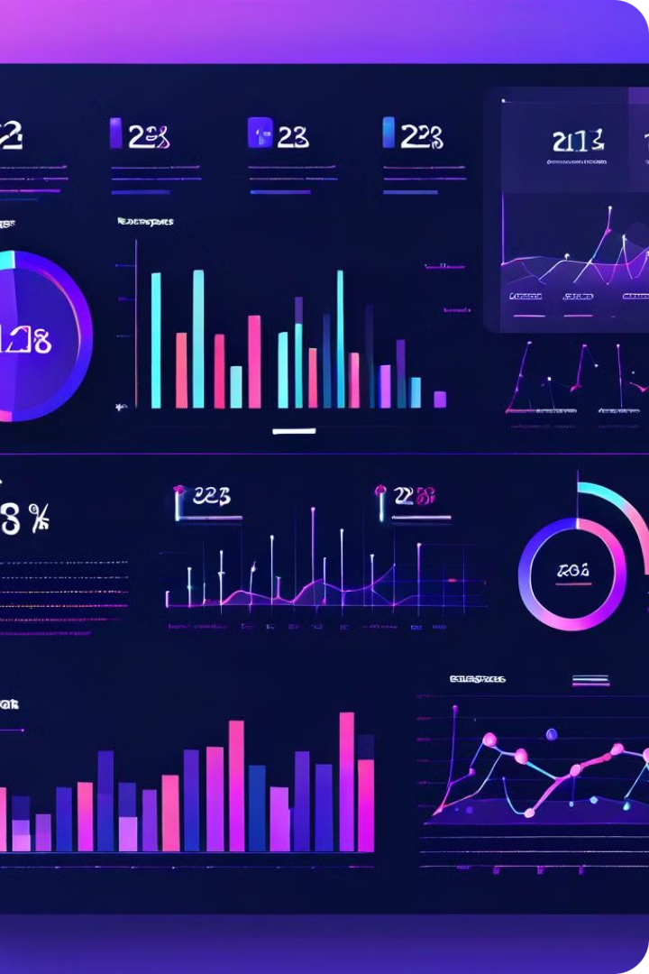
Summary of Findings
Comprehensive evaluation has revealed the chatbot's strong performance across key retrieval and generation metrics.

Slide 10

Thank You
We appreciate your time and attention throughout this presentation on our performance metrics evaluation. Your feedback will be invaluable as we continue to enhance our chatbot's capabilities.

